Slide 1

Цифровая и микроконтроллерная техника
Vlasov Sergey
smvlasov@itmo.ru

Slide 2
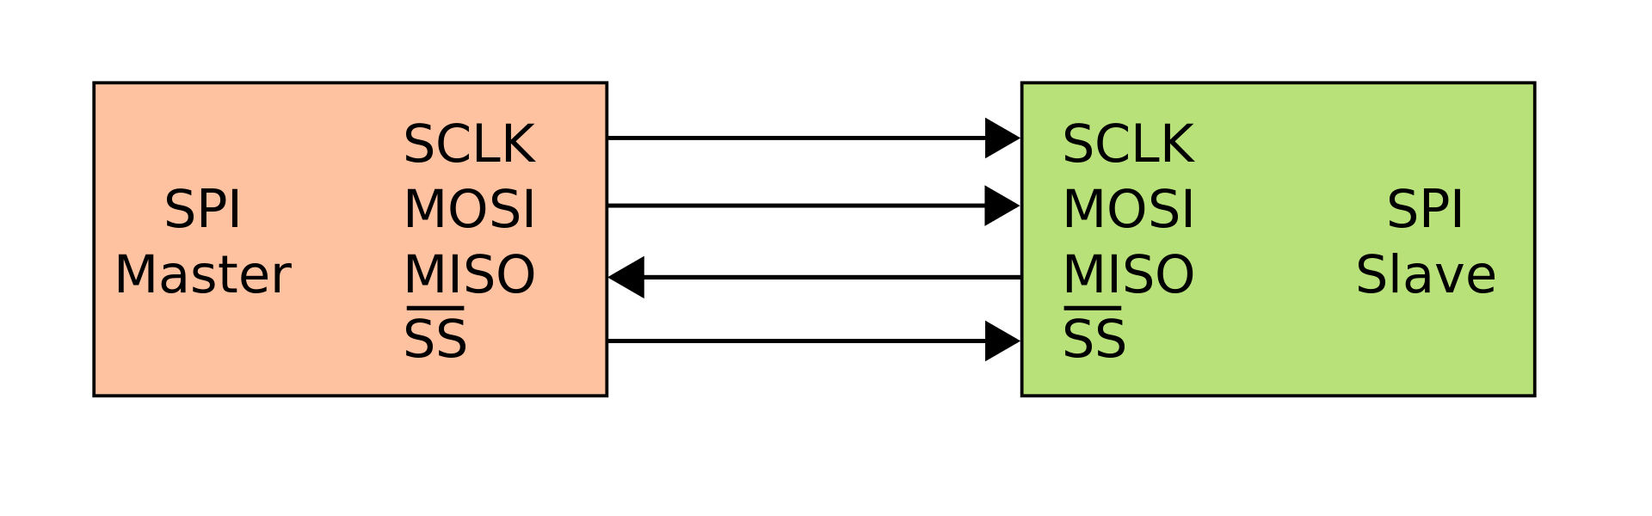
Serial Peripheral Interface

Slide 3
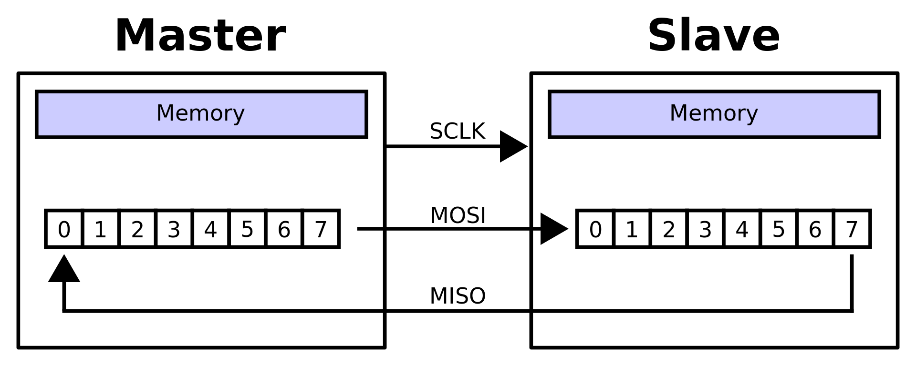
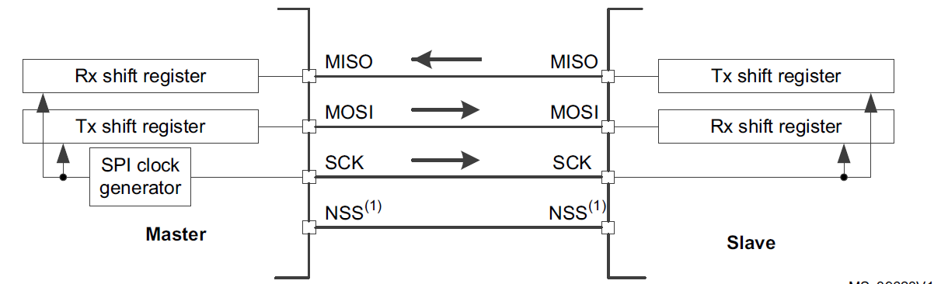
Serial Peripheral Interface

Slide 4
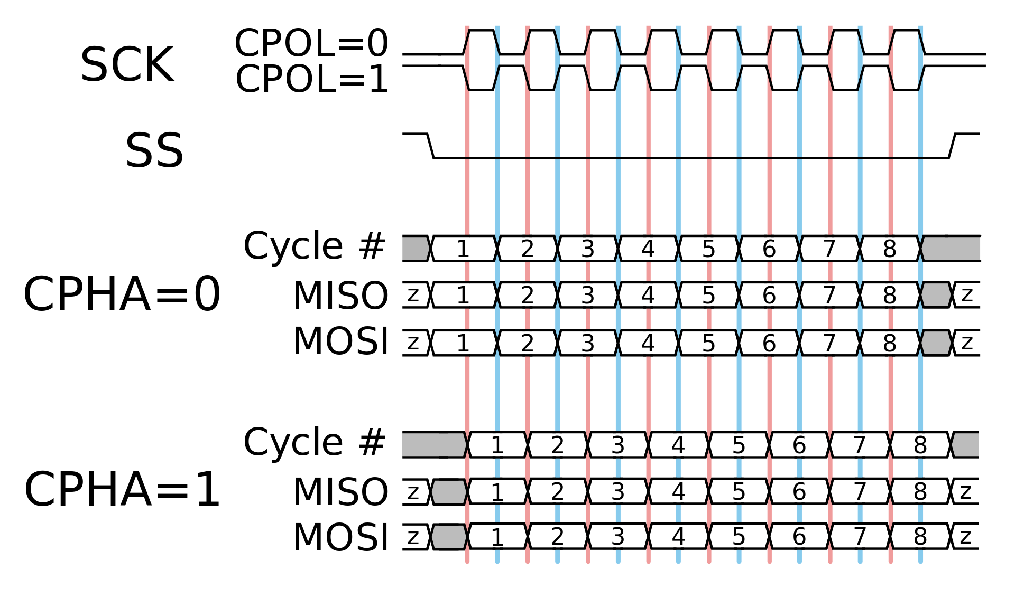
Serial Peripheral Interface

Slide 5
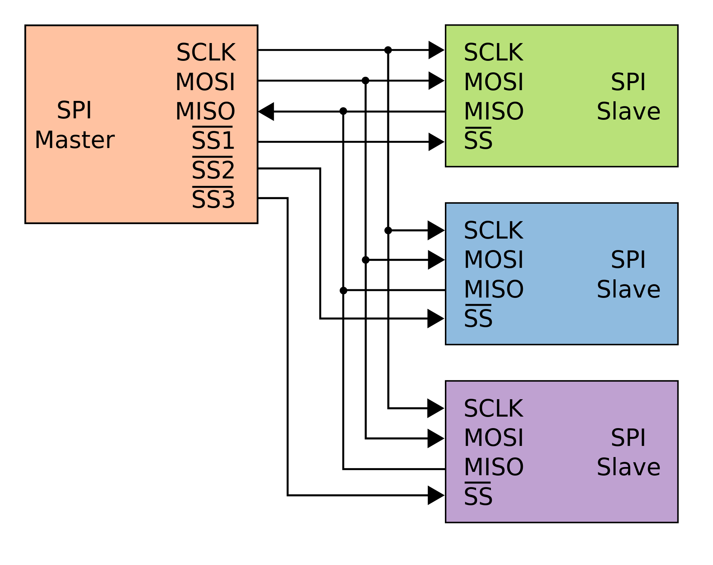
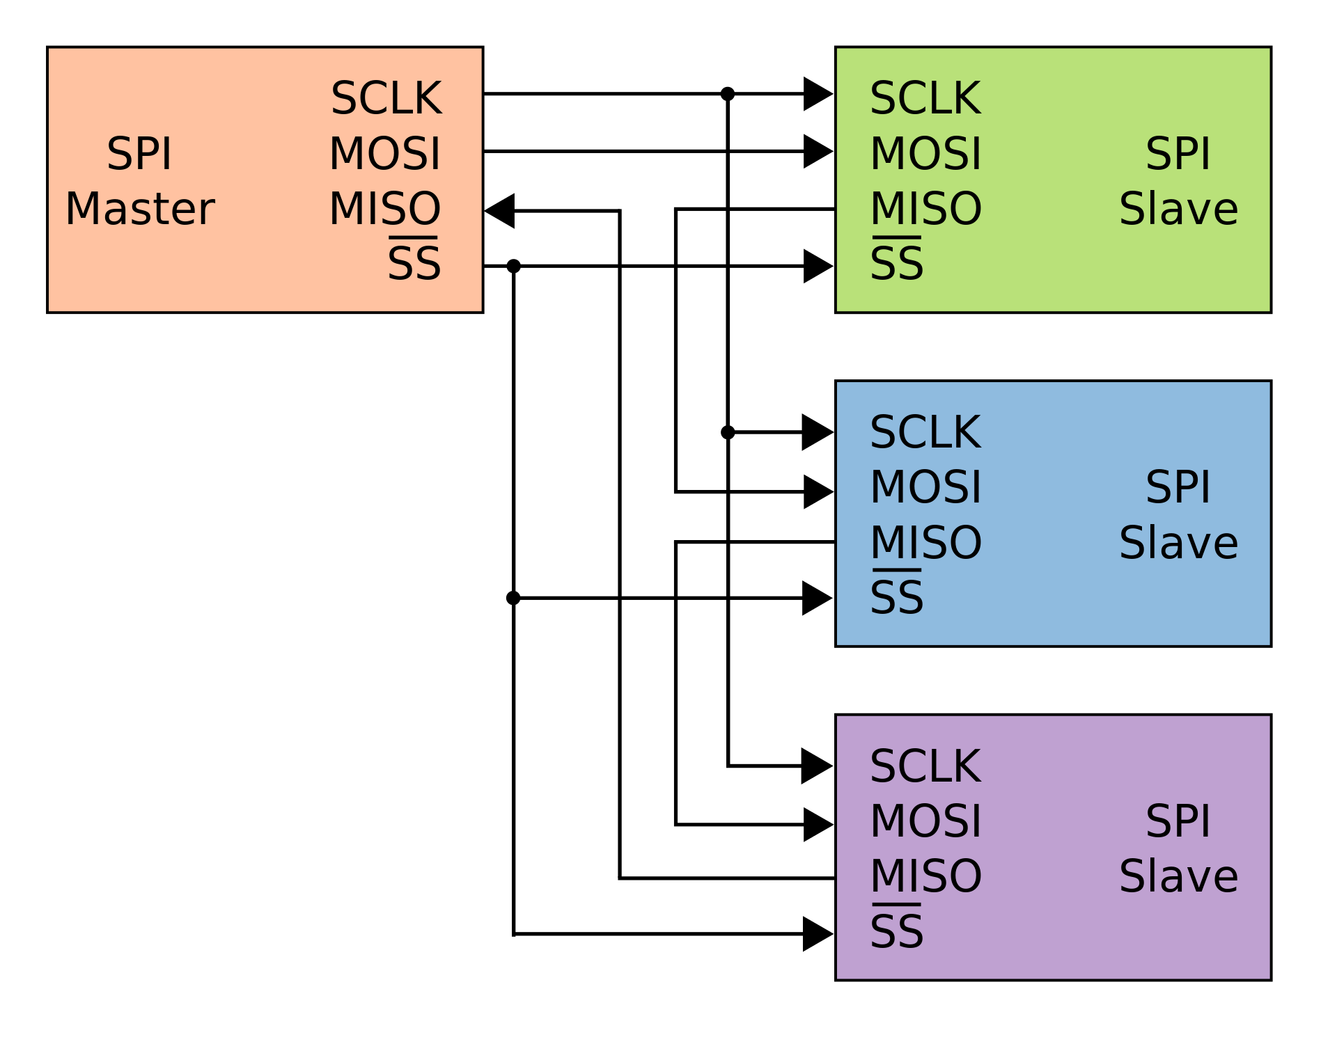
Serial Peripheral Interface

Slide 6
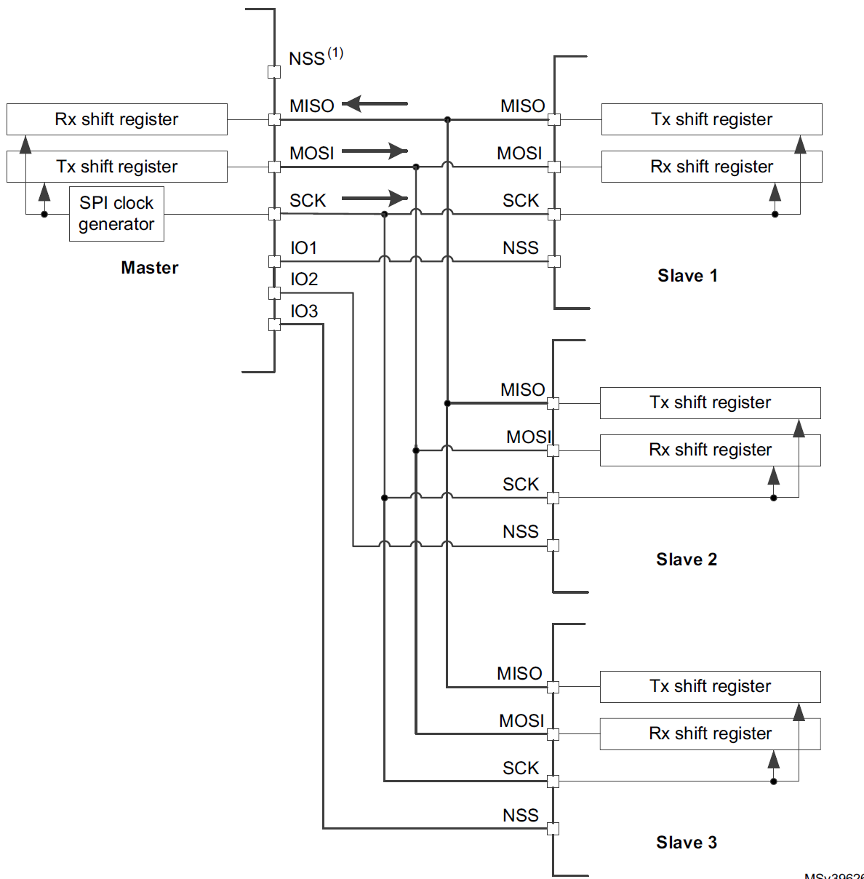
Serial Peripheral Interface

Slide 7
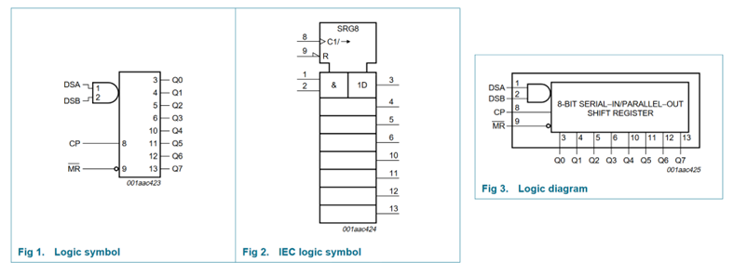
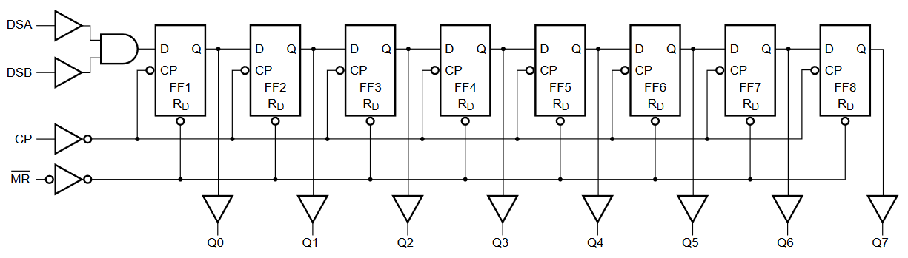
Serial Peripheral Interface
74HC164

Slide 8
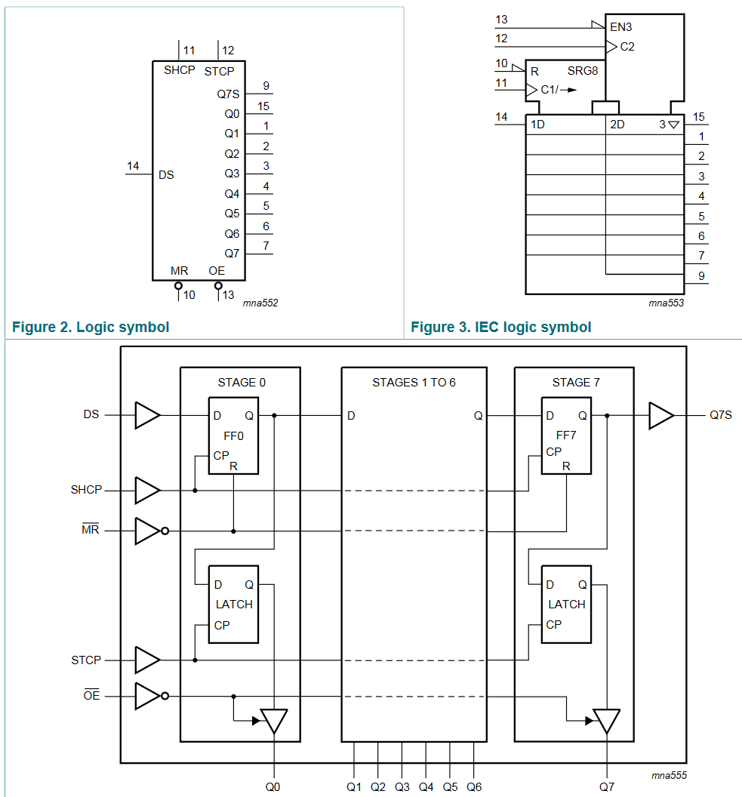
Serial Peripheral Interface

Slide 9
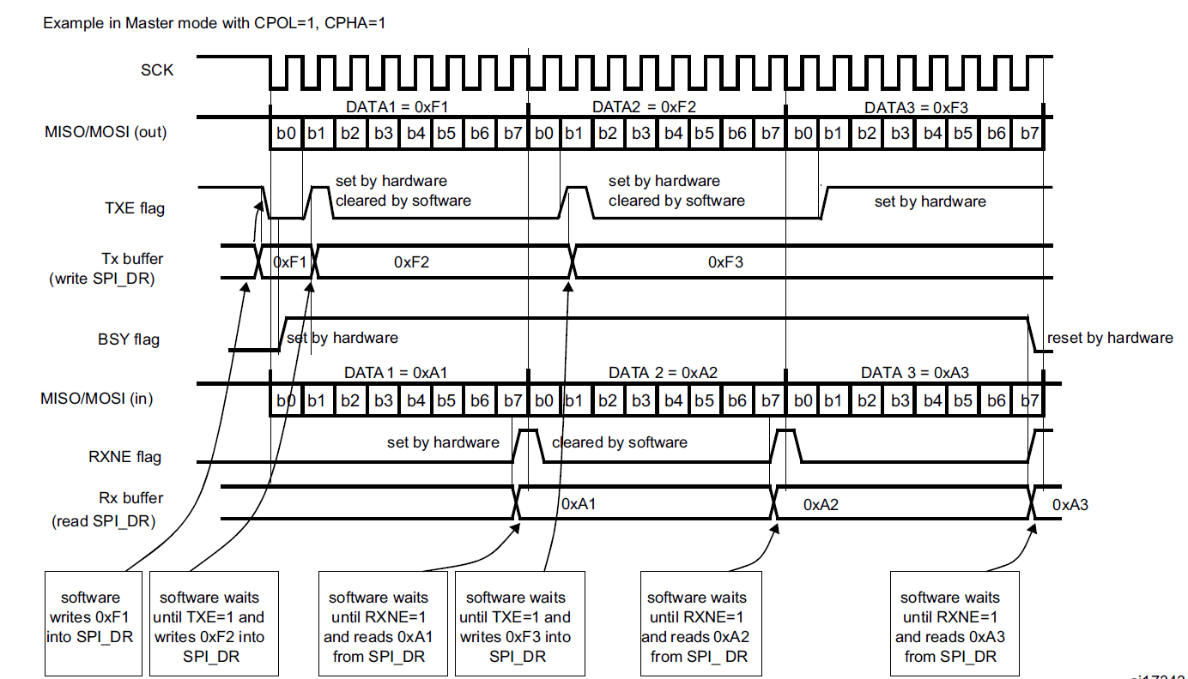
Serial Peripheral Interface

Slide 10
SPI registers
SPI control register 1 (SPI_CR1)
SPI control register 2 (SPI_CR2)
SPI status register (SPI_SR)
SPI data register (SPI_DR)
SPI CRC polynomial register (SPI_CRCPR)
SPI RX CRC register (SPI_RXCRCR)
SPI TX CRC register (SPI_TXCRCR)
SPI_I2S configuration register (SPI_I2SCFGR)
SPI_I2S prescaler register (SPI_I2SPR)

Slide 11
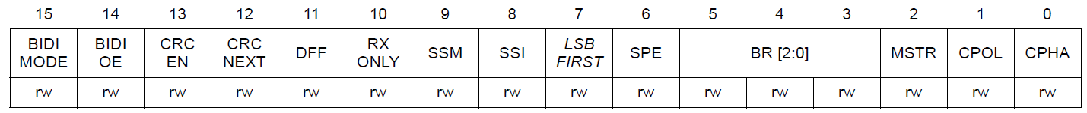
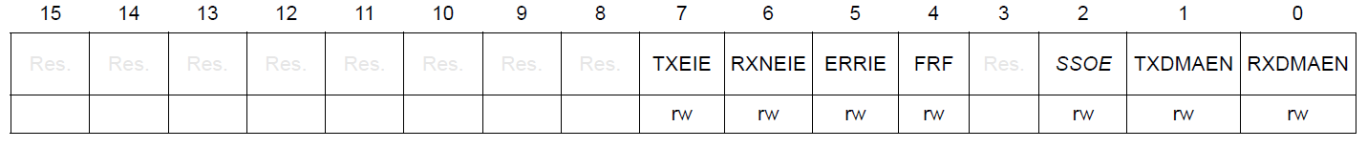
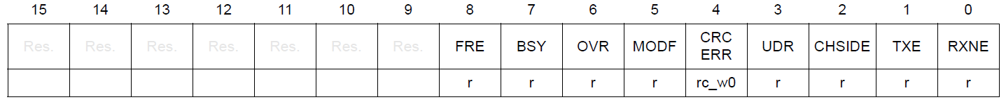
SPI registers
SPI control register 1 (SPI_CR1)
Address offset: 0x00
SPI control register 2 (SPI_CR2)
Address offset: 0x04
SPI status register (SPI_SR)
Address offset: 0x08

Slide 12
SPI registers RX only
SPI2->CR1 = SPI_CR1_RXONLY |
SPI_CR1_SSM |
SPI_CR1_SSI |
SPI_CR1_MSTR |
SPI_CR1_BR_0 |
SPI_CR1_BR_2;
SPI2->CR2 = SPI_CR2_RXDMAEN;
setup DMA
SPI2->CR1 |= SPI_CR1_SPE;

Slide 13
SPI registers TX
SPI1->CR1 = SPI_CR1_DFF |
SPI_CR1_SSM |
SPI_CR1_SSI |
SPI_CR1_SSM |
SPI_CR1_SSI |
SPI_CR1_MSTR |
SPI_CR1_BR_0 |
SPI_CR1_BR_1;
SPI1->DR = 0x1402;
SPI1->CR1 |= SPI_CR1_SPE;
uint8_t t=0;
while((SPI1->SR & SPI_SR_BSY) || (t < 150))
t++;

Slide 14

Thank you for attention
www.ifmo.ru

